Slide 1
Style Sheets

Slide 2
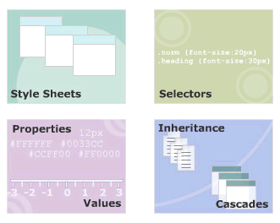
Module Introduction
Welcome to the module, Style Sheets.
This module introduces you to style sheets.
It also discusses how to use Cascading Style Sheets to format XML document.
Finally, the module explains the cascading order of style rules.
In this module, you will learn about:
  Stylesheets
  Selectors in CSS
  Properties and Values
  Inheritance and Cascades in CSS

Slide 3
#1 - Style Sheets
Define and describe style sheets
Define and describe cascading style sheets (CSS)
Explain how to implement styles with CSS

Slide 4
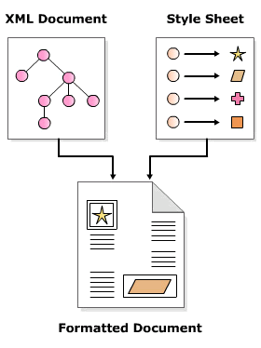
What is Style Sheets?
A set of rules that describe the appearance of data in an XML document.
XML describes data.
Style sheets define the appearance of data.
XML and style sheets are defined in separate files.
External Style Sheets are stored in CSS files
Multiple style definitions will cascade into one

Slide 5

Various Style Sheets
Cascading Style Sheet
  Control the appearance of data in HTML and XML
Extensible Style Sheet
  Define the appearance of data contained only in XML documents.
  Also allows you to transform XML documents.

Slide 6
Cascading Style Sheets
Comprises a set of rules for various elements in a document.
Each rule defines how the data enclosed in the element should be displayed.

Slide 7
External style sheets
Written style rules in a file with the extension “.css”
Using style sheet processing instruction associated style-sheet file with an XML document.
  It should appear in the prolog section of an XML document
  One XML document can have more than one style sheet
syntax
Example

Slide 8
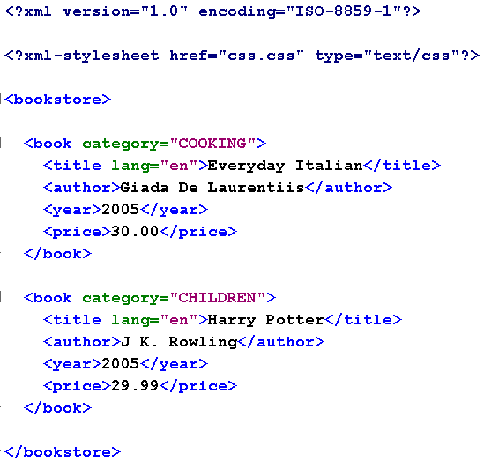
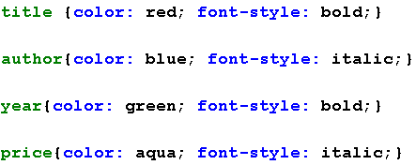
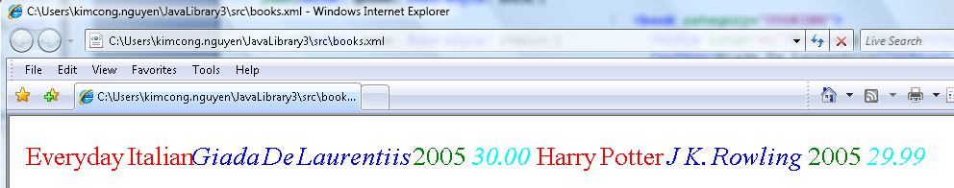
Example of Using External Style Sheets
books.xml
css.css

Slide 9

Style rules
Style rules defines how the content enclosed in an element will be displayed.
Applicable to all child elements within an element.
A style rule comprises:
  Selector
    Is an element name of an XML document
  Property
    Is a CSS style property that defines how the element will be rendered.
  Value
    The value associated with a CSS property.

Slide 10
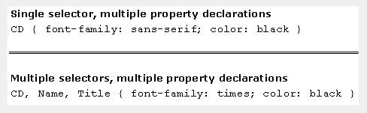
Ways of writing Style rules
A single selector can have more than one property-value pairs associated with it.
  property -value pairs are separated by a semi-colon (;)
A collection of one or more property-value pairs can be associated with more than one selector.

Slide 11
#2 – Selector in CSS
Identify simple selectors in CSS
State the use of universal selector in CSS
Describe ID selectors

Slide 12
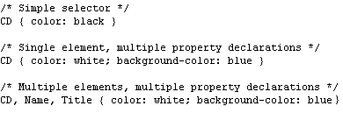
Simple Selectors
Comprises an element name followed by one or more property declarations.
Same property declarations can be assigned to multiple elements by separating element names with a comma.
Simple selectors match every occurrence of the element in a document.

Slide 13
Universal Selector
Comprises an asterisk (*) followed by property declarations.
Use to assign the same style rules to all the elements in a document.
Example:

Slide 14
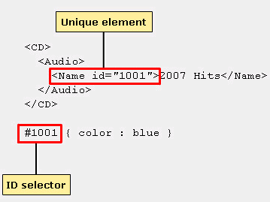
ID Selector
Comprises a hash (#) symbol + an attribute's value + property declarations.
Use to define styles for unique elements in a document.

Slide 15
#3 - Properties and Values
State and describe how to use color properties
Describe the font property.
Describe the other properties
  Margins
  Borders
  Padding
  Positioning
  alignment.

Slide 16


Color Properties ($1/8)
To set the foreground and background color of text.
syntax
example

Slide 17
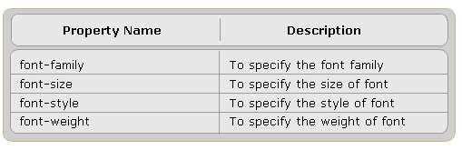
Font Properties ($2/8)
To set the font properties

Slide 18
Margins in CSS ($3/8)
Every element in an XML document is displayed in its own box.
CSS provides four properties to insert space around the element's box
  Margin-left
  Margin-right
  Margin-top
  Margin-bottom.

Slide 19


Border Properties in CSS ($4/8)
Borders are rectangular outlines surrounding an element's box
syntax
example
output

Slide 20


Padding Properties in CSS ($5/8)
To insert space between the border and the text of an element,
syntax
example
output

Slide 21
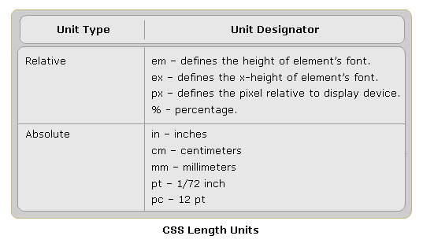
CSS Units
The values assigned to CSS properties are expressed in length units.

Slide 22
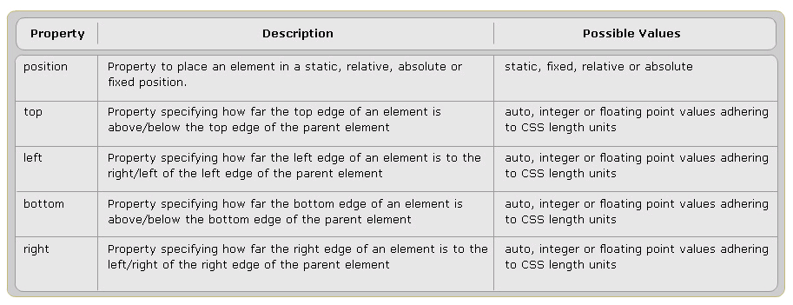
Position Properties ($6/8)
To position the text inside the box.

Slide 23


Position Properties Example
example
output

Slide 24



Display property ($7/8)
In HTML, if you wanted the text to appear as new paragraph, you would use the <P> tag.
The same can be achieved in XML by using CSS display property.
syntax
ouput
example

Slide 25


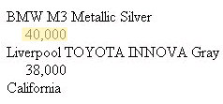
Text Alignment and Indentation ($8/8)
To align and indent the text in their own box
syntax
example
output

Slide 26
Properties and Values Review
Color properties
Font property
Margins
Borders
Padding
Positioning
Alignment.
Like CSS in HTML

Slide 27
#4 - Inheritance and Cascades in CSS
Define the process of cascading
Explain inheritance.

Slide 28
Cascading in CSS
One document can have more than one style sheet defined
  It is possible that more than one style rule may exist for an element.
W3C defines the rules to determine what style to apply to an element:
  All declarations that apply to an element and property are grouped.
  Declarations are sorted by weight and origin.
  Declarations are sorted by specificity of selector.
  Declarations are sorted by the order specified.

Slide 29
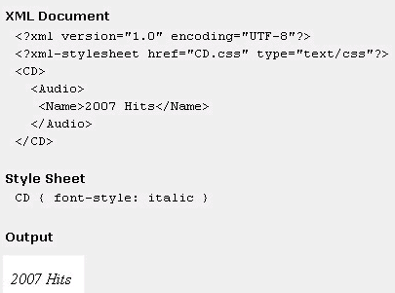
Inheritance in CSS
The ability of one entity to acquire the characteristics of another entity.
In CSS, the child elements inherit the styles rules defined for parent element.
If the child has style rule, its rule will overrides the parent style rule.

Slide 30
That’s about all for today!
Stylesheets
Selectors in CSS
Properties and Values
Inheritance and Cascades in CSS
Thank you all for your attention and patient !

